Slide 1
Linear Algebra Primer
And a video discussion of linear algebra from EE263 is here (lectures 3 and 4):
https://see.stanford.edu/Course/EE263
slides from Stanford CS131

Slide 2
Vector spaces
a vector space or linear space (over the reals) consists of
I a set V
I a vector sum + : V ⇥ V ! V
I a scalar multiplication : R ⇥ V ! V
I a distinguished element 0 2 V
which satisfy a list of properties
2

Slide 3
Vector space axioms
I x + y = y + x, 8x, y 2 V
I (x + y)+ z = x + (y + z),
I 0+ x = x, 8x 2 V
+ is commutative
8x, y, z 2 V
+ is associative
0 is additive identity
I 8x 2 V 9(-x) 2 V s.t. x + (-x) = 0
I (↵f3)x = ↵(f3x), 8↵, f3 2 R 8x 2 V
existence of additive inverse
scalar mult. is associative
I ↵(x + y) = ↵x + ↵y,
I (↵ + f3)x = ↵x + f3x,
I 1x = x, 8x 2 V
8↵ 2 R 8x, y 2 V
8↵, f3 2 R 8x 2 V
right distributive rule
left distributive rule
1 is multiplicative identity
2

Slide 4
Examples
I V1 = R^{n}, with standard (componentwise) vector addition and scalar multi- plication
I V2 = {0} (where 0 2 R^{n})
I V3 = span(v1, v2,. .., vk ) where
span(v1, v2,. .., vk ) = {↵1v1 + ·· · + ↵kvk | ↵i 2 R}
and v1,. .., vk 2 R^{n}
2

Slide 5
Subspaces
I a subspace of a vector space is a subset of a vector space which is itself a vector space
I roughly speaking, a subspace is closed under vector addition and scalar mul- tiplication
I examples V1, V2, V3 above are subspaces of R^{n}
2

Slide 6
Vector spaces of functions
I V4 = {x : R+ ! R^{n} | x is di↵erentiable}, where vector sum is sum of func-
tions:
(x + z)(t) = x(t)+ z(t)
and scalar multiplication is defined by
(↵x)(t) = ↵x(t)
(a point in V4 is a trajectory in R^{n})
I V5 = {x 2 V4 | x˙ = Ax}
(points in V5 are trajectories of the linear system x˙ = Ax)
I V5 is a subspace of V4
2

Slide 7
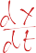
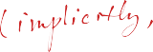
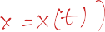


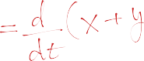
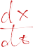
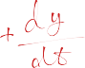
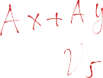
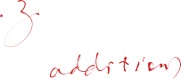

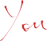
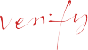
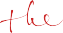
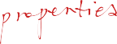

Slide 8
Basis and dimension
set of vectors {v1, v2,. .., vk } is called a basis for a vector space V if
V = span(v1, v2,. .., vk )
and
{v1, v2,. .., vk } is independent
I equivalently, every v 2 V can be uniquely expressed as
v = ↵1v1 + ·· · + ↵kvk
I for a given vector space V, the number of vectors in any basis is the same
I number of vectors in any basis is called the dimension of V, denoted dim V
10

Slide 9
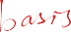
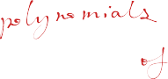
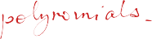

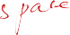
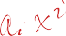
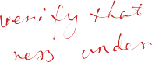
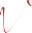

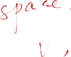
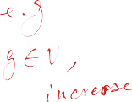
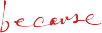

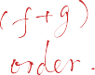
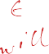
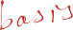


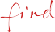
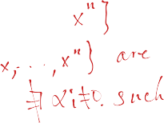
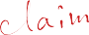
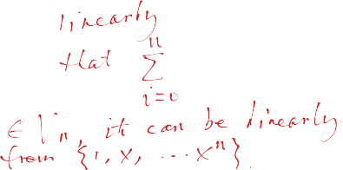
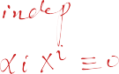
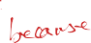

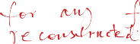

Slide 10
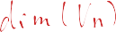
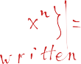
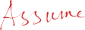
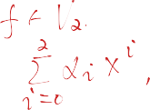
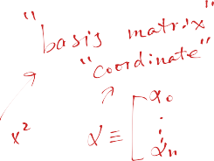
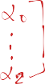
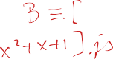

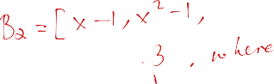
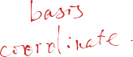

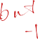
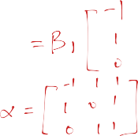
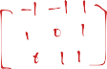
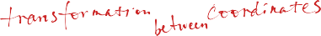

Slide 11
Nullspace of a matrix
the nullspace of A 2 R^{m⇥n} is defined as
n
null(A) = { x 2 R | Ax = 0 }
I null(A) is set of vectors mapped to zero by y = Ax
I null(A) is set of vectors orthogonal to all rows of A
null(A) gives ambiguity in x given y = Ax:
I if y = Ax and z 2 null(A), then y = A(x + z)
I conversely, if y = Ax and y = Ax˜, then x˜ = x + z for some z 2 null(A)
null(A) is also written N (A)
11

Slide 12
Zero nullspace
A is called one-to-one if 0 is the only element of its nullspace
null(A) = {0}
Equivalently,
I x can always be uniquely determined from y = Ax
(i.e., the linear transformation y = Ax doesn’t ‘lose’ information)
I mapping from x to Ax is one-to-one: di↵erent x’s map to di↵erent y’s
I columns of A are independent (hence, a basis for their span)
I A has a left inverse, i.e., there is a matrix B 2 R^{n⇥m} s.t. BA = I
I A^{T}A is invertible
11

Slide 13
Range of a matrix
the range of A 2 R^{m⇥n} is defined as
n
m
range(A) = {Ax | x 2 R } ✓ R
range(A) can be interpreted as
I the set of vectors that can be ‘hit’ by linear mapping y = Ax
I the span of columns of A
I the set of vectors y for which Ax = y has a solution
range(A) is also written R(A)
15

Slide 14
Outline
Vectors and matrices
Basic Matrix Operations
Determinants, norms, trace
Special Matrices
Transformation Matrices
Homogeneous coordinates
Translation
Matrix inverse
Matrix rank
Eigenvalues and Eigenvectors
Matrix Calculus
2

Slide 15
Outline
Vectors and matrices
Basic Matrix Operations
Determinants, norms, trace
Special Matrices
Transformation Matrices
Homogeneous coordinates
Translation
Matrix inverse
Matrix rank
Eigenvalues and Eigenvectors(SVD)
Matrix Calculus
78

Slide 16
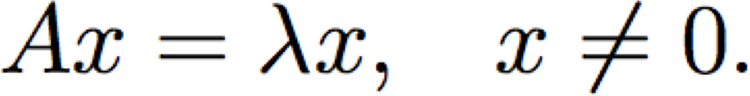
Eigenvector and Eigenvalue
An eigenvector x of a linear transformation A is a non-zero vector that, when A is applied to it, does not change direction.
79

Slide 17
Eigenvector and Eigenvalue
An eigenvector x of a linear transformation A is a non-zero vector that, when A is applied to it, does not change direction.
Applying A to the eigenvector only scales the eigenvector by the scalar value λ, called an eigenvalue.
80

Slide 18
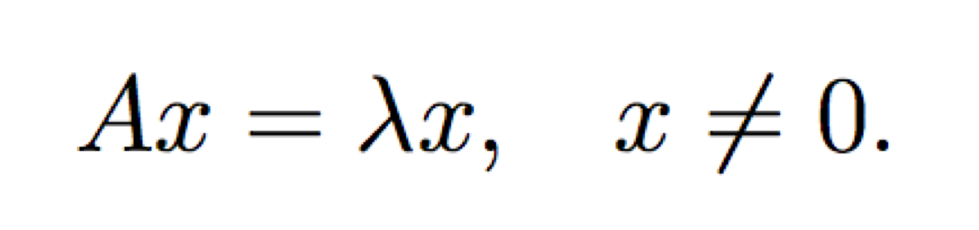
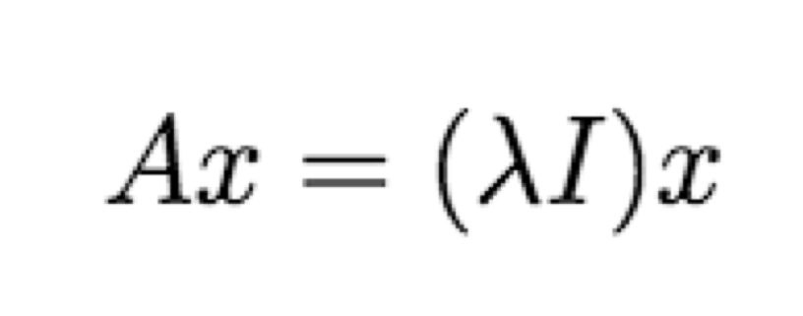
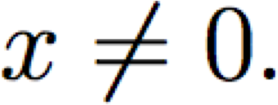
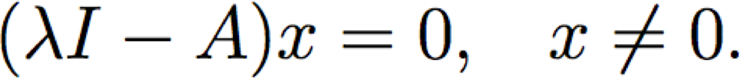
Eigenvector and Eigenvalue
We want to find all the eigenvalues of A:
Which can we written as:
Therefore:
81

Slide 19

Eigenvector and Eigenvalue
We can solve for eigenvalues by solving:
Since we are looking for non-zero x, we can instead solve the above equation as:
82

Slide 20
Spectral theory
We call an eigenvalue λ and an associated eigenvector an eigenpair.
The space of vectors where (A − λI) = 0 is often called the eigenspace of A associated with the eigenvalue λ.
The set of all eigenvalues of A is called its
spectrum:
87

Slide 21
Diagonalization
An n × n matrix A is diagonalizable if it has n linearly independent eigenvectors.
Most square matrices (in a sense that can be made mathematically rigorous) are diagonalizable:
Normal matrices are diagonalizable
Matrices with n distinct eigenvalues are diagonalizable
Lemma: Eigenvectors associated with distinct eigenvalues are linearly independent.
91

Slide 22
Diagonalization
An n × n matrix A is diagonalizable if it has n linearly independent eigenvectors.
Most square matrices are diagonalizable:
Normal matrices are diagonalizable
Matrices with n distinct eigenvalues are diagonalizable
Lemma: Eigenvectors associated with distinct eigenvalues are linearly independent.
92

Slide 23


Diagonalization
Eigenvalue equation:
– Where D is a diagonal matrix of the eigenvalues
93

Slide 24

Diagonalization
Eigenvalue equation:
Assuming all λ_{i}’s are unique:
Remember that the inverse of an orthogonal matrix is just its transpose and the eigenvectors are orthogonal
94

Slide 25

Symmetric matrices
Properties:
For a symmetric matrix A, all the eigenvalues are real.
The eigenvectors of A are orthonormal.
95

Slide 26



Symmetric matrices
Therefore:
– where
So, if we wanted to find the vector x that:
96

Slide 27
Symmetric matrices
Therefore:
where
So, if we wanted to find the vector x that:
Is the same as finding the eigenvector that corresponds to the largest eigenvalue.
97

Slide 28














Slide 29


Properties
The trace of a A is equal to the sum of its eigenvalues:
The determinant of A is equal to the product of its eigenvalues
84

Slide 30

















Slide 31
Properties
The trace of a A is equal to the sum of its eigenvalues:
The determinant of A is equal to the product of its eigenvalues
The rank of A is equal to the number of non-zero eigenvalues of A.

Slide 32



Slide 33
Properties
The trace of a A is equal to the sum of its eigenvalues:
The determinant of A is equal to the product of its eigenvalues
The rank of A is equal to the number of non-zero eigenvalues of A.
The eigenvalues of a diagonal matrix D = diag(d1,
. . . dn) are just the diagonal entries d1, . . . dn

Slide 34
Spectral theory
We call an eigenvalue λ and an associated eigenvector an eigenpair.
The space of vectors where (A − λI) = 0 is often called the eigenspace of A associated with the eigenvalue λ.
The set of all eigenvalues of A is called its
spectrum:

Slide 35
Spectral theory
The magnitude of the largest eigenvalue (in magnitude) is called the spectral radius
– Where C is the space of all eigenvalues of A

Slide 36

























Slide 37

Spectral theory
The spectral radius is bounded by infinity norm of a matrix:
Proof: Turn to a partner and prove this!

Slide 38

Spectral theory
The spectral radius is bounded by infinity norm of a matrix:
Proof: Let λ and v be an eigenpair of A:

Slide 39










EE263 Autumn 2015
S. Boyd and S. Lall
Singular Value Decomposition
1

Slide 40
Geometry of linear maps
v₁
v₂
!
û₂u₂
û₁u₁
every matrix A 2 R^{m⇥n} maps the unit ball in R^{n} to an ellipsoid in R
m
S = ^{n}x 2 R^{n I} kxk  1º
AS = ^{n}Ax ^{I} x 2 Sº
2

Slide 41
Singular values and singular vectors
v₁
û₂u₂
v₂
!
û₁u₁
I first, assume A 2 R^{m⇥n} is skinny and full rank
I the numbers O'1,. .., O'n > 0 are called the singular values of A
I the vectors u1,. .., un are called the left or output singular vectors of A. These are unit vectors along the principal semiaxes of AS
I the vectors v1,. .., vn are called the right or input singular vectors of A. These map to the principal semiaxes, so that
Avi = O'iui
3

Slide 42
Thin singular value decomposition
Avi = O'iui for 1 i n
For A 2 R^{m⇥n} with Rank(A) = n, let
² O'1
3
U = ⇥ u
u ·· · u
⇤
⌃ =
6
O'2
.
7
V = ⇥ v
v ·· · v
⇤
1
2
n
4
. .
5
1
2
n
O'n
the above equation is AV = U ⌃ and since V is orthogonal
A = U ⌃V ^{T}
called the thin SVD of A
4

Slide 43
Thin SVD
For A 2 R^{m⇥n} with Rank(A) = r, the thin SVD is
X
T
r
T
A = U ⌃V = O' u v
i=1
i
i i
=
A
U
⌃
_{V} T
here
I U 2 R^{m⇥r} has orthonormal columns,
I ⌃ = diag(O'1,. .., O'r ), where O'1 2: · · · 2: O'r > 0
I V 2 R^{n⇥r} has orthonormal columns
5

Slide 44
SVD and eigenvectors
A^{T}A = (U ⌃V ^{T})^{T}(U ⌃V ^{T}) = V ⌃²V ^{T}
hence:
I vi are eigenvectors of A^{T}A (corresponding to nonzero eigenvalues)
I O'i = ^{p},\i(A^{T}A) (and ,\i(A^{T}A) = 0 for i> r)
I kAk = O'1
6

Slide 45
SVD and eigenvectors
similarly,
AA^{T} = (U ⌃V ^{T})(U ⌃V ^{T})^{T} = U ⌃²U ^{T}
hence:
I ui are eigenvectors of AA^{T} (corresponding to nonzero eigenvalues)
I O'i = ^{p},\i(AA^{T}) (and ,\i(AA^{T}) = 0 for i> r)
7

Slide 46
SVD and range
A = U ⌃V ^{T}
I u1,. .. ur are orthonormal basis for range(A)
I v1,. .. vr are orthonormal basis for null(A)?
8

Slide 47
Interpretations
X
T
r
T
i
A = U ⌃V = O' u v
i=1
i i
x
_{V} T
T
⌃
T
U
V x
⌃V x
Ax
linear mapping y = Ax can be decomposed as
I compute coeffcients of x along input directions v1,. .., vr
I scale coeffcients by O'i
I reconstitute along output directions u1,. .., ur
di↵erence with eigenvalue decomposition for symmetric A: input and output direc- tions are di↵erent
9

Slide 48



General pseudo-inverse
T
if A 6= 0 has SVD A = U ⌃V , the pseudo-inverse or Moore-Penrose inverse of A is
A† = V ⌃⁻¹U ^{T}
I if A is skinny and full rank,
A† = (A^{T}A)⁻¹A^{T}
gives the least-squares approximate solution xls = A†y
I if A is fat and full rank,
A† = A^{T}(AA^{T})⁻¹
gives the least-norm solution xln = A†y
14

Slide 49
Full SVD
SVD of A 2 R^{m⇥n} with Rank(A) = r
3 2 3
² O'1
v
T
⇥
1
T
. . .
7 6 7
A = U ⌃ V = u
·· ·
.
ur ^{⇤ 6}4
5 4 5
1 1 1
1
.
O'r
_{v}T
r
Add extra columns to U and V , and add zero rows/cols to ⌃1
=
A
U
⌃
_{V} T
17

Slide 50
Full SVD
I find U2 2 R^{m⇥(m-r)} such that U = ⇥ U1 U2 ⇤ 2 R^{m⇥m} is orthogonal
I find V2 2 R^{n⇥(n-r)} such that V = ⇥ V1 V2 ⇤ 2 R^{n⇥n} is orthogonal
I add zero rows/cols to ⌃1 to form ⌃ 2 R^{m⇥n}
#
⌃ = "
⌃1
⁰r⇥(n - r)
⁰(m - r)⇥r
⁰(m - r)⇥(n - r)
then the full SVD is
⇤ "
#
⇥
⌃1
⁰r⇥(n - r)
V
T
l
T
1
A = U1⌃1V₁ =
U1 U2
0
(m - r)⇥r
0
(m - r)⇥(n - r)
_{V} T
2
which is A = U ⌃V ^{T}
18

Slide 51
example: SVD
2 ₁ ₂ 3
4
1
5
A = 3
4 2
SVD is
2
-0.319
3 2
3
l
4
0.915 -0.248 5.747 0
1.403
0
-0.880 -0.476
-0.476 0.880
A = -0.542
-0.391 -0.744
-0.103 0.620
5 4
0
0
5
-0.778
19

Slide 52
Image of unit ball under linear transformation
full SVD:
A = U ⌃V ^{T}
gives intepretation of y = Ax:
I rotate (by V ^{T})
I stretch along axes by O'i (O'i = 0 for i> r)
I zero-pad (if m> n) or truncate (if m< n) to get m-vector
I rotate (by U )
20

Slide 53

Image of unit ball under A
1
1
1
rotate by V ^{T}
1
stretch, Σ = diag(2, 0.5)
u2
u1
rotate by U
0.5
2
{Ax | kxk  1} is ellipsoid with principal axes O'iui.
21

Slide 54
Some applications of Eigenvalues
PageRank
Schrodinger’s equation
PCA

Slide 55
Outline
Vectors and matrices
Basic Matrix Operations
Determinants, norms, trace
Special Matrices
Transformation Matrices
Homogeneous coordinates
Translation
Matrix inverse
Matrix rank
Eigenvalues and Eigenvectors(SVD)
Matrix Calculus

Slide 56


Matrix Calculus – The Gradient
Let a function take as input a matrix A of size m × n and returns a real value.
Then the gradient of f:

Slide 57


Matrix Calculus – The Gradient
Every entry in the matrix is:
the size of ∇_{A}f(A) is always the same as the size of A. So if A is just a vector x:

Slide 58


Exercise
Example:
Find:

Slide 59


Exercise
Example:
From this we can conclude that:

Slide 60

Matrix Calculus – The Gradient
Properties

Slide 61


Matrix Calculus – The Hessian
The Hessian matrix with respect to x, written or simply as H is the n × n matrix of
partial derivatives

Slide 62

Matrix Calculus – The Hessian
Each entry can be written as:
Exercise: Why is the Hessian always symmetric?

Slide 63

Matrix Calculus – The Hessian
Each entry can be written as:
The Hessian is always symmetric, because
This is known as Schwarz's theorem: The order of partial derivatives don’t matter as long as the second derivative exists and is continuous.

Slide 64

Matrix Calculus – The Hessian
Note that the hessian is not the gradient of whole gradient of a vector (this is not defined). It is actually the gradient of every entry of the gradient of the vector.

Slide 65


Matrix Calculus – The Hessian
Eg, the first column is the gradient of

Slide 66


Exercise
Example:
110

Slide 67

Exercise

Slide 68

Exercise
Divide the summation into 3 parts depending on whether:
i == k or
j == k

Slide 69

Exercise

Slide 70


Exercise

Slide 71


Exercise

Slide 72


Exercise

Slide 73
Exercise

Slide 74

Exercise

Slide 75



Exercise

Slide 76

Exercise
120

Slide 77


Exercise

Slide 78
What we have learned
Vectors and matrices
Basic Matrix Operations
Special Matrices
Transformation Matrices
Homogeneous coordinates
Translation
Matrix inverse
Matrix rank
Eigenvalues and Eigenvectors
Matrix Calculate

